Slide 1


CAPTURE THE FLAG
Challenging Cyber Security Enthusiasts
Presented_By ://_Debdulal_De

Slide 2

BRIEF INTRODUCTION ABOUT MYSELF
I am Debdulal De, a first-year undergraduate student of the Department of Industrial and Systems Engineering enrolled in its B-tech course. I am a boarder of Pandit Modan Mohan Malviya Hall of Residence. I am from Jhargram, West Bengal.
I am here to briefly explain Cybersecurity and The Capture The Flag (CTF) Competition.

Slide 3





TABLE OF CONTENTS
01
02
03
04

Slide 4


CYBERSECURITY & HACKING
01

Slide 5
BASICS OF CYBERSECURITY
Fields In Cybersecurity:
Network Security
Information Security Management
Cryptography
Security Engineering
Ethical Hacking/Penetration Testing
Security Consulting
Definition: Cybersecurity involves protecting computer systems, networks, and data from unauthorized access or damage.
Importance:
With the increasing reliance on technology, cybersecurity is crucial to safeguard sensitive information and prevent cyber attacks.

Slide 6

CONCEPT OF HACKING
DEFINITION:
Hacking refers to unauthorized intrusion into computer systems or networks to gain access, manipulate data, or disrupt operations.
TYPES OF HACKERS:
Hackers can be classified as white hat (ethical hackers), black hat (malicious hackers), or grey hat (a combination of both).
MOTIVATIONS:
Hacking can be driven by financial gain, political agendas, personal challenges, or curiosity.

Slide 7


CYBER THREATS & THEIR IMPACT
02

Slide 8


DIFFERENT TYPES OF CYBER THREATS
MALWARE
PHISHING
D-O-S ATTACKS
Social engineering attacks trick users into revealing sensitive information or downloading malicious content.
It can lead to identity theft, financial fraud, unauthorized access to accounts, and compromised systems.
Overloading a system with traffic to make it inaccessible to legitimate users.
It can lead to service downtime, financial losses, customer dissatisfaction, and reputational damage.
Viruses, worms, Trojans, and ransomware can infect systems, steal data, or disrupt operations.
Malware can result in data breaches, financial loss, system crashes, and reputational damage.

Slide 9


CAPTURE THE FLAG
03

Slide 10
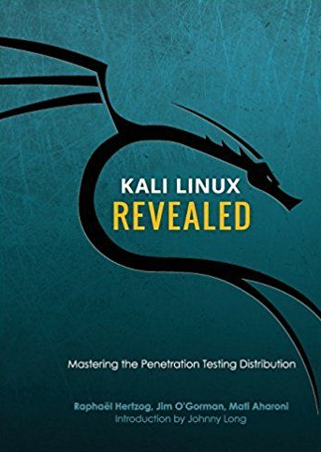
INTRODUCTION
CTF competitions are exciting and educational events in the cybersecurity field.
They simulate real-world hacking scenarios in a controlled environment.
Participants compete to solve a series of challenges and capture "flags" to earn points. Flags are usually unique strings or codes hidden within the challenges, representing successful exploitation or solution.

Slide 11
CATEGORIES AND CHALLENGES
1. BINARY EXPLOITATION
Participants solve encryption and decryption challenges, crack codes, or identify weaknesses in cryptographic implementations.
Participants analyze and exploit vulnerabilities in compiled programs or binaries.
2. CRYPTOGRAPHY
3. REVERSE ENGINEERING
Participants disassemble and understand the functionality of provided software or firmware
Participants extract hidden messages or data from images, audio files, or other media.
4. STEGANOGRAPHY
5. WEB SECURITY
Participants analyze provided digital artifacts, such as network traffic captures, log files, memory dumps, or disk images, to uncover hidden information.
Participants discover and exploit vulnerabilities in web applications, such as injection attacks, cross-site scripting (XSS), etc.
6. FORENSICS

Slide 12




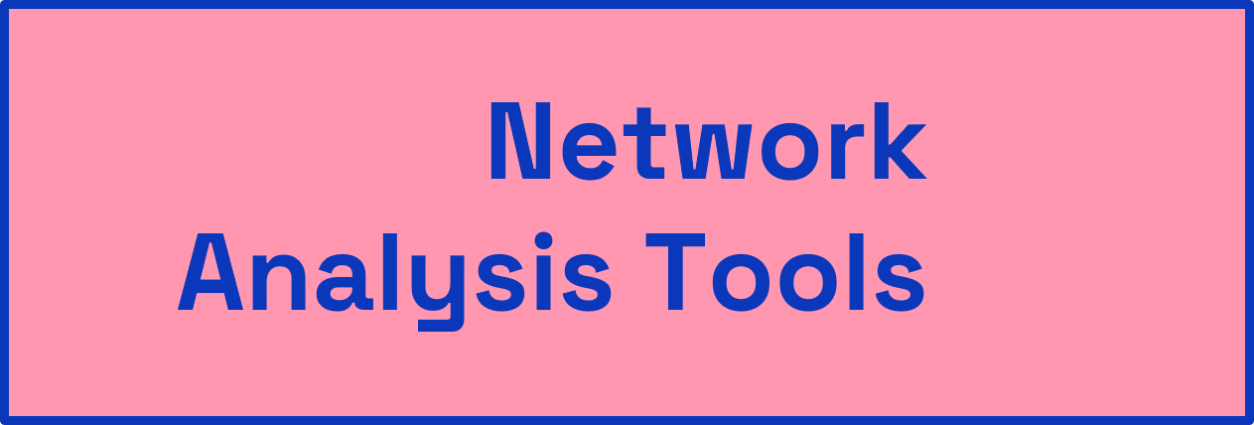
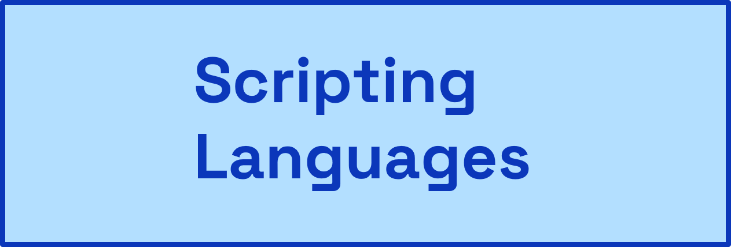
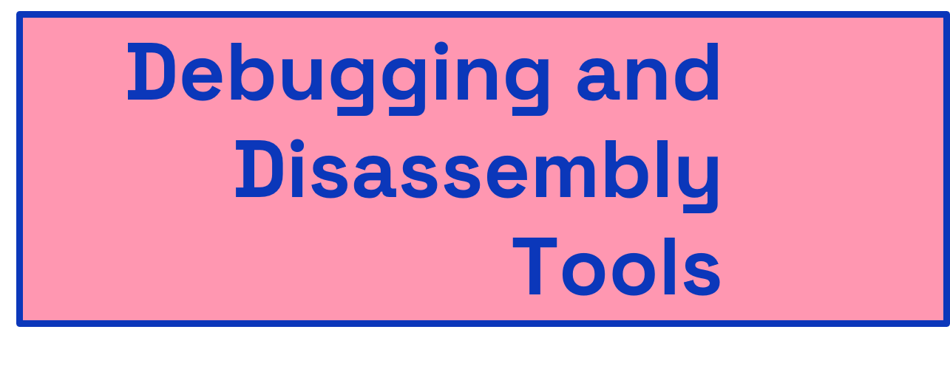
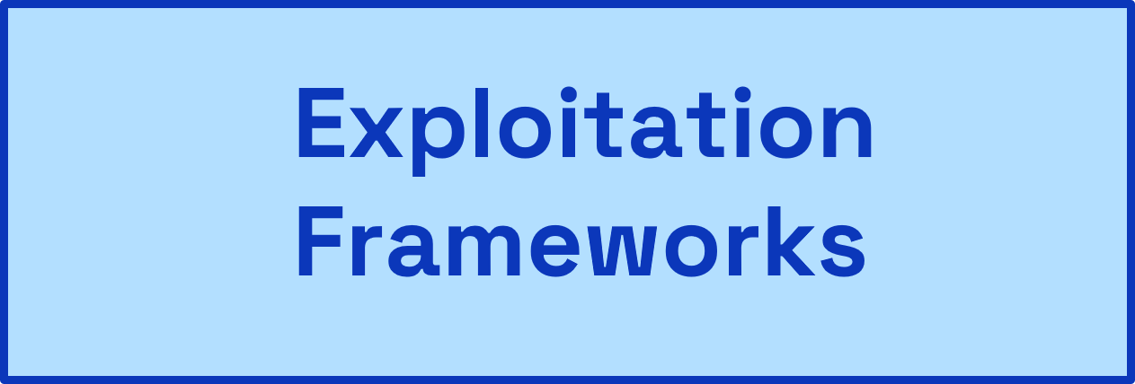
TOOLS AND TECHNIQUES USED IN CTF

Slide 13
SCRIPTING LANGUAGES
BASH SCRIPT EXAMPLE
DEFINITION :
A scripting language or script language is a programming language that is used to manipulate, customize, and automate the facilities of an existing system. Scripting languages are usually interpreted at runtime rather than compiled.
POPULAR SCRIPT LANGUAGES :
JavaScript :
It enables scripting for hacking purposes by providing a powerful and flexible toolset for exploiting vulnerabilities, manipulating web content, and automating malicious activities on the client side.
Python :
A widely-used, versatile scripting language renowned for its simplicity, readability, and vast user community, empowering diverse applications such as web development, data analysis, machine learning, and automation.
Bash :
The widely-used Unix-like scripting language (Bourne Again SHell) for Linux and macOS, features a command-line interface, task automation, and a large user base among system administrators and developers.
#!/bin/bash
echo "Hello! What's your name?"
read name
echo "Nice to meet you, $name!"
Hello! What's your name?
> Debdulal De
Nice to meet you Debdulal De
PYTHON SCRIPT EXAMPLE
#!/bin/python3
num = int(input(“Enter a number: “))
sqr = num **2
print("The square of", num, "is", sqr)
Enter a number: 5
The square of 5 is 25

Slide 14

NETWORK ANALYSIS TOOLS
Wireshark Panel Example
DEFINITION :
Network analysis tools are used to examine and analyze network traffic, topology, performance, and security. They help in understanding network behavior, identifying bottlenecks, troubleshooting issues, and ensuring efficient network management.
POPULAR NETWORK ANALYSIS TOOL :
Wireshark :
A widely-used network protocol analyzer that captures and analyzes network packets in real time. It provides detailed insights into network traffic, and protocols, and can be used for network troubleshooting and security analysis.
Nmap :
A powerful and versatile network scanning tool used for network exploration and security auditing. It helps in discovering hosts, open ports, and services running on a network, aiding in vulnerability assessment and penetration testing.
Nmap Syntax
Basic TCP Scan : nmap <target IP>
nmap 192.168.119.130
Scan a Range of IPs : nmap <IP1>-<IP2>
nmap 192.168.1.1-192.168.1.100
Scan Specific Ports : nmap -p <ports> <IP>
nmap -p 80,443 192.168.198.130

Slide 15

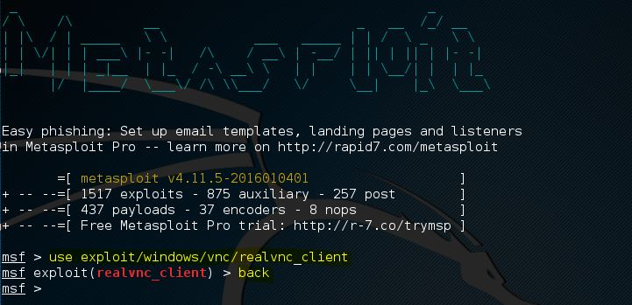
EXPLOITATION FRAMEWORKS
Burp Suite Panel Example
DEFINITION :
Exploitation frameworks are comprehensive software tools that facilitate the identification and exploitation of vulnerabilities in computer systems for security testing and ethical hacking purposes.
APPLICATIONS USE IN EXPLOITATION :
Metasploit :
Comprehensive penetration testing framework with a wide range of exploits and payloads.
Burp Suite :
Web application security testing tool for vulnerability identification and HTTP traffic manipulation.
Metasploit Syntax

Slide 16


DEBUGGING AND DISASSEMBLY TOOLS
GHIDRA
DEFINITION :
Debugging and disassembly tools are software utilities used to identify and analyze errors, faults, and vulnerabilities in computer programs by examining and interpreting their machine code instructions.
POPULAR DEBUGGING AND DISASSEMBLY TOOL :
Ghidra:
A powerful and feature-rich software application for reverse engineering, malware analysis, and vulnerability research.
IDA Pro :
Disassembler and debugger for analyzing binary code.
IDA Pro

Slide 17

RULES AND REGULATIONS
TIME CONSTRAINTS :
CTF competitions often have time limits, ranging from a few hours to several days. Participants must manage their time effectively to tackle as many challenges as possible within the given timeframe.
POINTS AND FLAG CAPTURE :
Each challenge has a specific flag that participants need to discover and capture. Flags are unique strings or codes that signify the successful exploitation or completion of a challenge. Participants submit the captured flags to the organizers to earn points.
COLLABORATION AND LEARNING :
CTF competitions provide an excellent opportunity for participants to collaborate, share knowledge, and learn from each other. Participants often discuss strategies, techniques, and solutions during the event, fostering a vibrant learning environment.
SCORING :
CTF competitions typically have a live scoreboard that displays the teams' rankings based on their accumulated points. The scoring system may award more points for more difficult challenges, and penalty points may be deducted for rule violations or incorrect flag submissions.

Slide 18
REVERSE ENGINEERING
04

Slide 19
INTRODUCTION
Developers write code in high-level languages such as C/C++
This code is then compiled into machine code - sequences of bytes that the CPU can interpret
Disassembly is the process of converting these byte sequences into assembly instructions
As reverse engineers, these byte sequences will be our starting point
#Compilation Review
Compiling a program is a multi-stage process
1. Pre-processing 2. Compilation
3. Assembly 4. Linking
The result is machine code that is run on the CPU
These steps are all typically performed automatically
After going through these steps, an executable is produced

Slide 20
STAGES OF COMPILATION
Compiling is phase two of “compilation” Pre-processing passes over the source code, performing:
Comment removal
Macro Expansion
Include Expansion
Conditional Compilation
Compiling converts the output of the pre-processor into assembly instructions
Assembly
The output of the compilation process can take many forms:
PE (Windows)
ELF (Linux)
Mach-O (OSX)
COFF/ECOFF
This output file is often your starting point as a reverse engineer
Assemblers convert the assembly code into binary opcodes
Each instruction is represented by a binary opcode
mov rax, 1 = 0x48C7C001000000
The assembler will produce an object file
Object files contain machine code
This file will contain fields to be filled by the linker
Pre-processing & Compilation
Linking

Slide 21
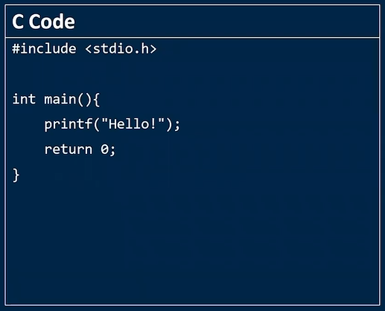
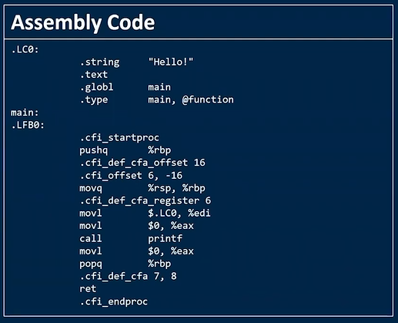
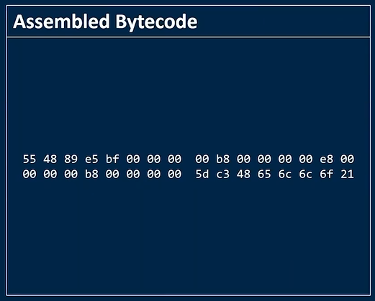
COMPILATION TIMELINE
ASSEMBLE
COMPILATION
EXECUTABLE ELF FILE

Slide 22
ELF FILES OVERVIEW
ELF = Executable Linking Format.
It contains information identifying:
OS, endianness, etc
ELF files provide the information needed for execution by the OS
ELF Files can be broken up into three components
ELF Header
Sections
Segments

Slide 23
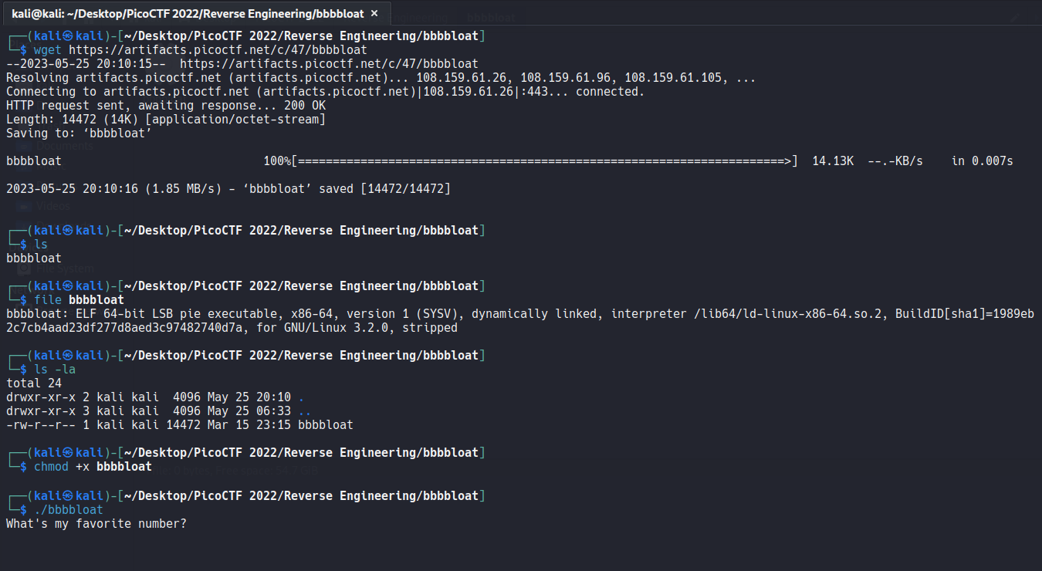
REVERSE ENGINEERING WITH GHIDRA
1. INFORMATION GATHERING
For this project, I am reverse engineering PicoCTF 2022 #bbbbloat.
So first just download from PicoCTF and check the file type and gather as much information as possible

Slide 24
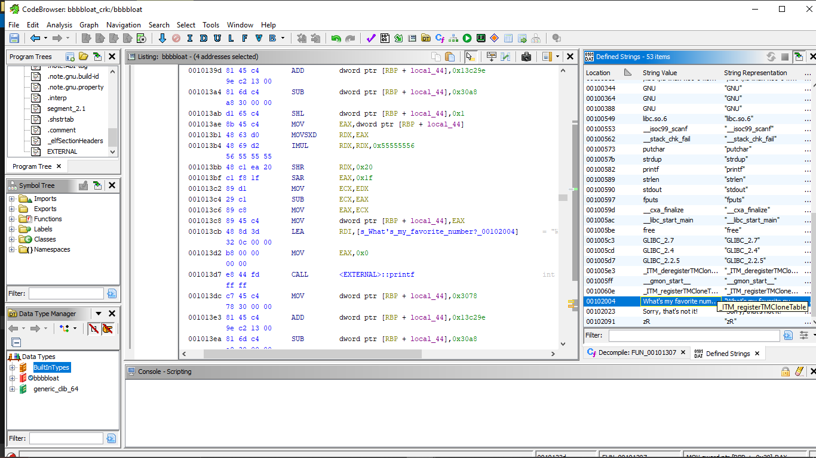
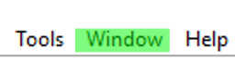
REVERSE ENGINEERING WITH GHIDRA
2. USE OF GHIDRA

Slide 25
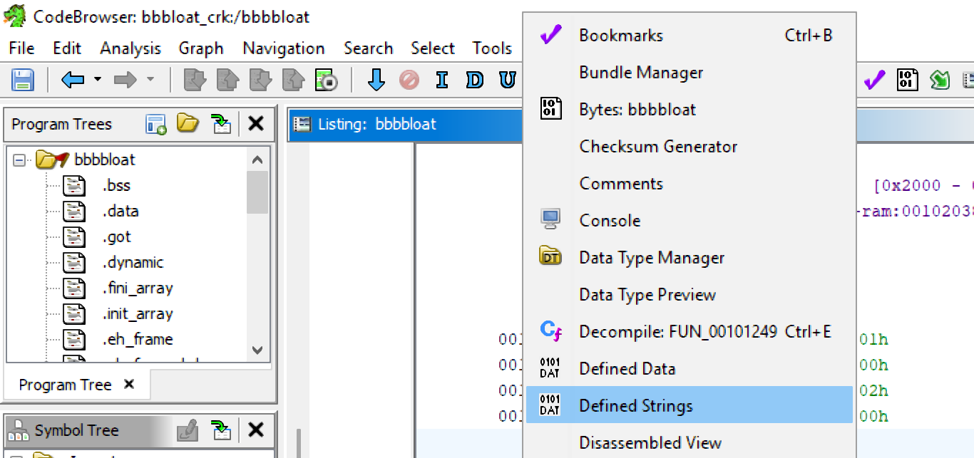

REVERSE ENGINEERING WITH GHIDRA
2. USE OF GHIDRA

Slide 26
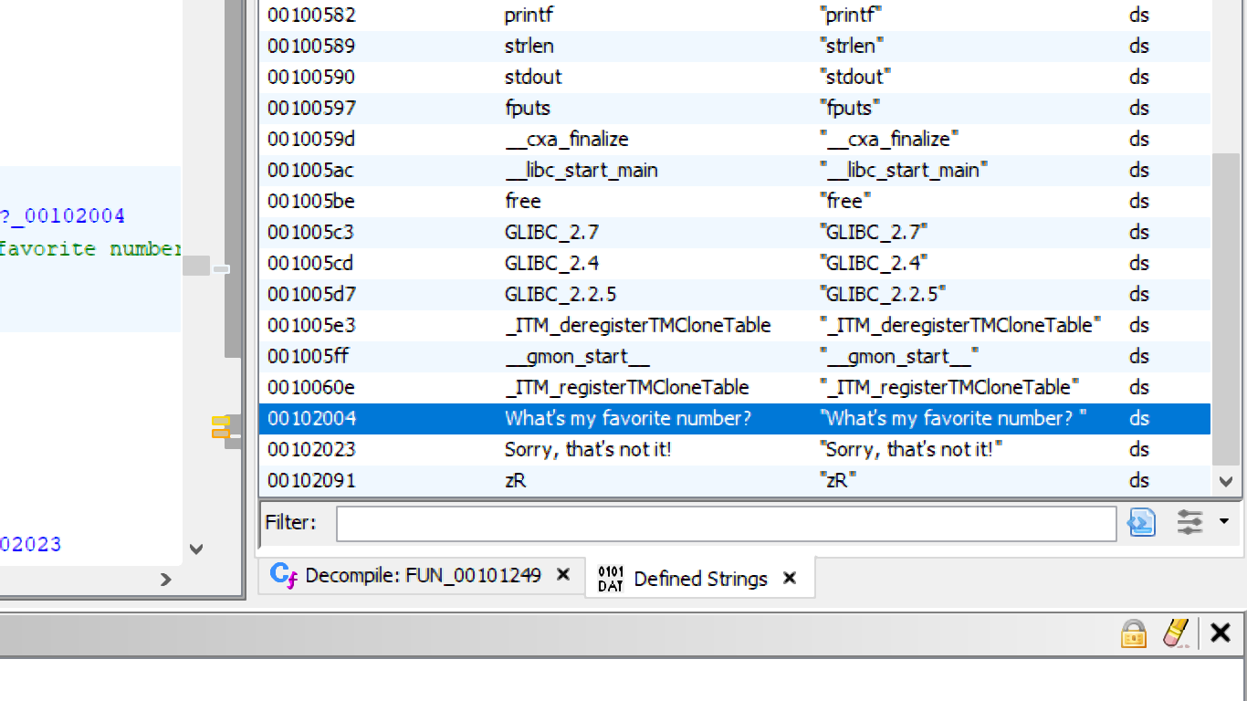
REVERSE ENGINEERING WITH GHIDRA
2. USE OF GHIDRA

Slide 27
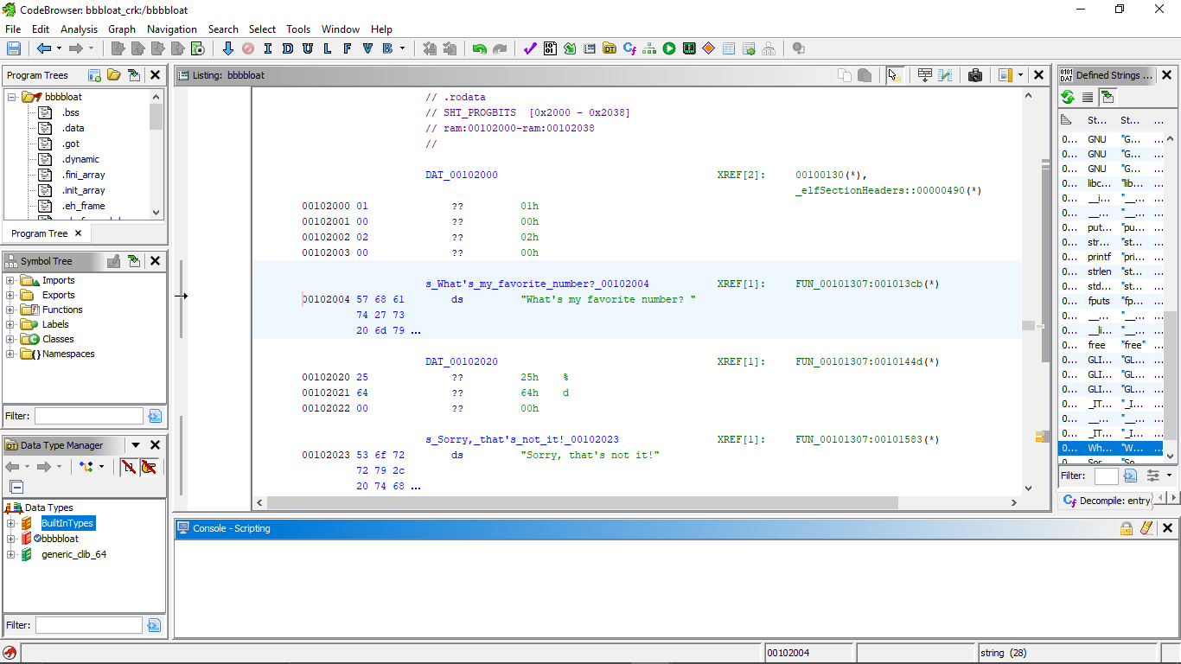
REVERSE ENGINEERING WITH GHIDRA
2. USE OF GHIDRA

Slide 28
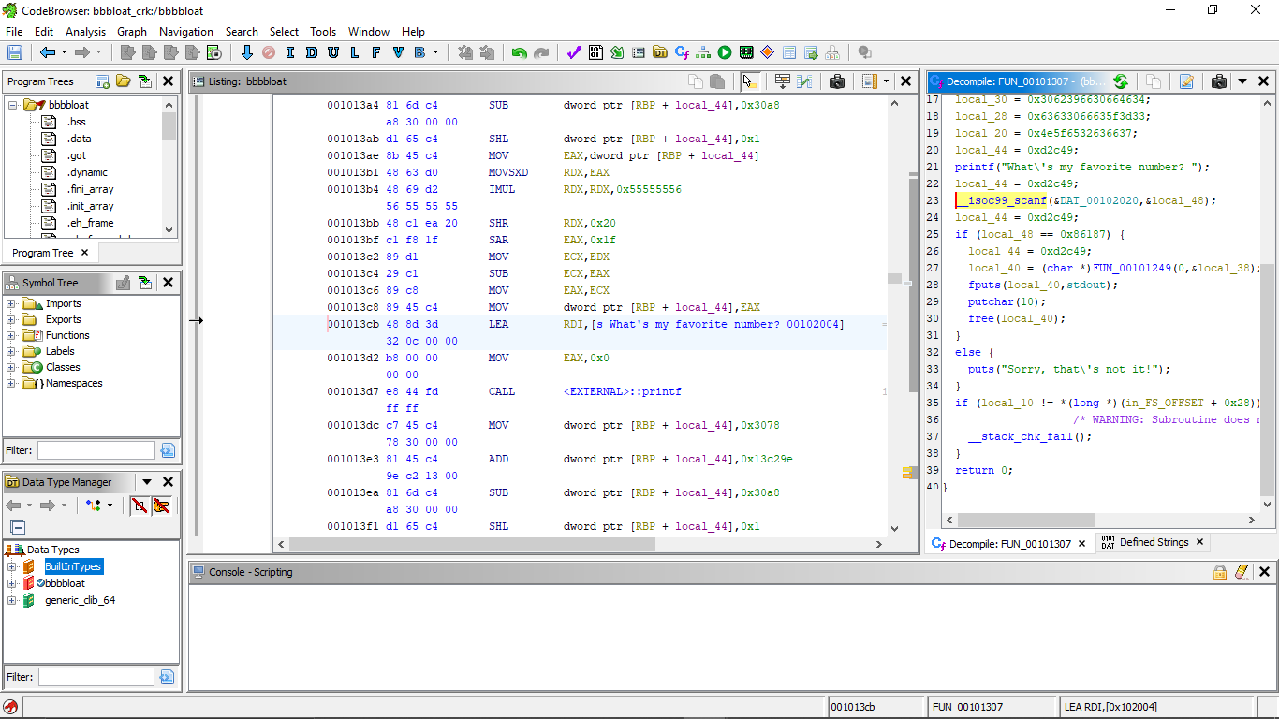
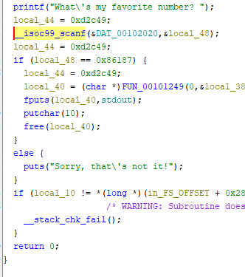
REVERSE ENGINEERING WITH GHIDRA
2. USE OF GHIDRA

Slide 29
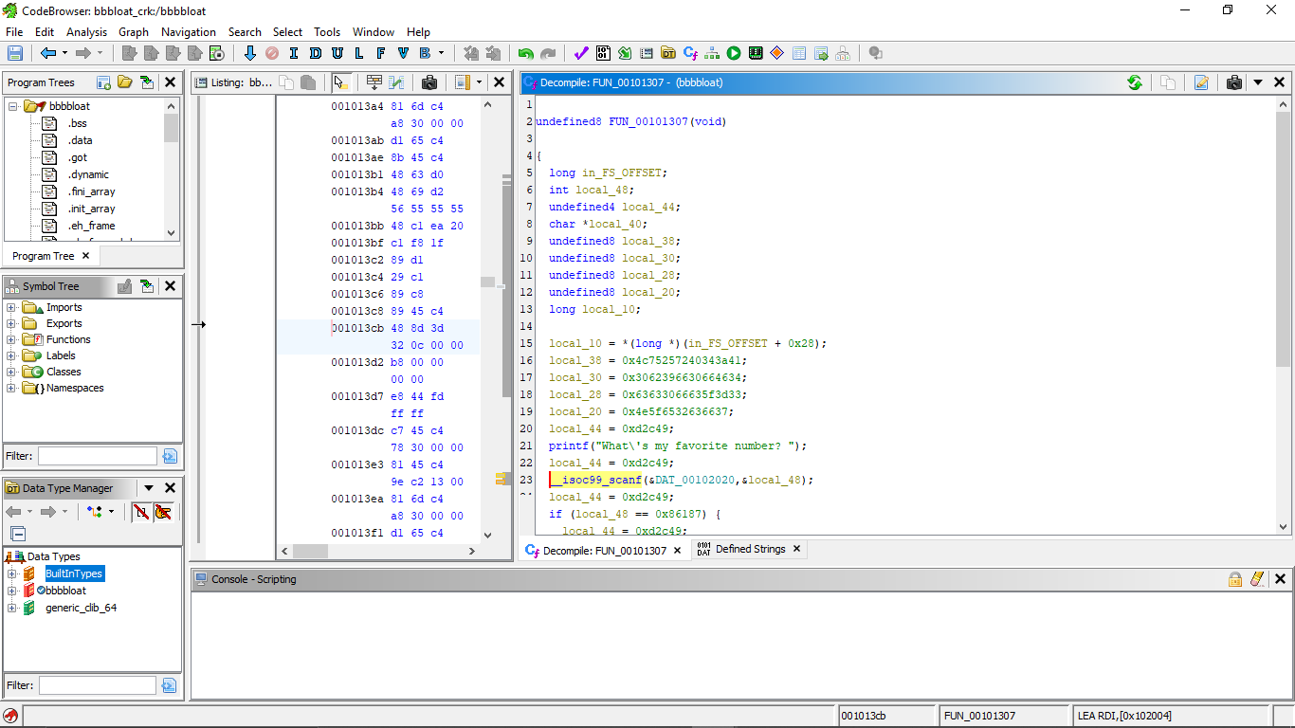
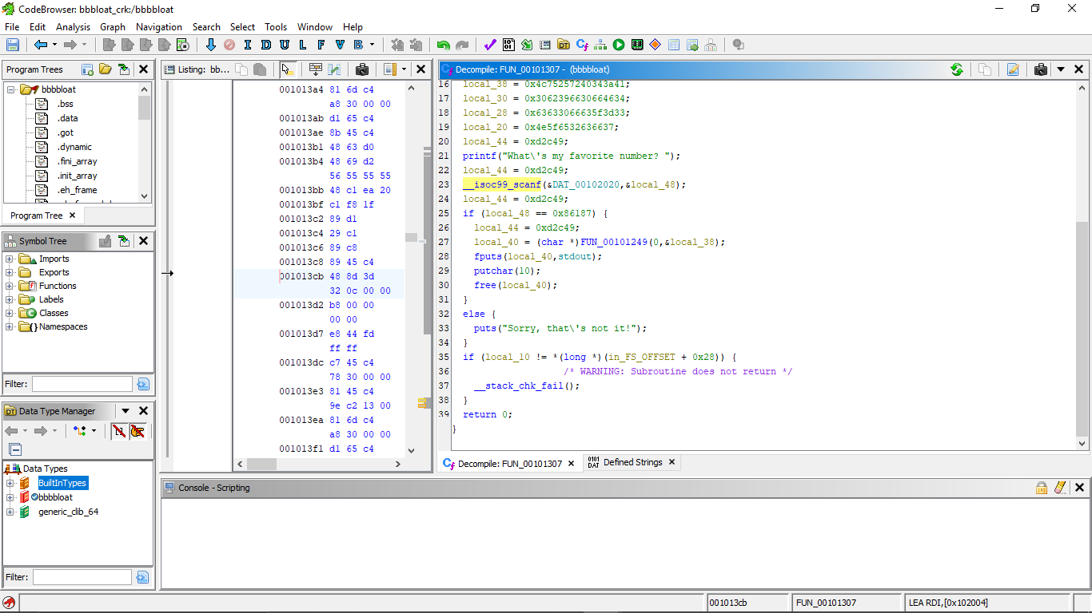
REVERSE ENGINEERING WITH GHIDRA
2. USE OF GHIDRA

Slide 30
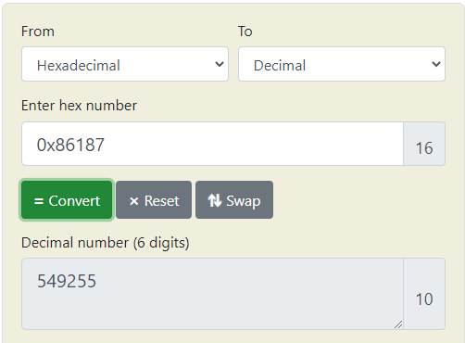
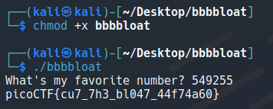
RESULT
So We get to know my favorite is number 549255
After pasting it to the terminal we get our picoCTF flag.

Slide 31
CONCLUSION
In conclusion, understanding the basics of cybersecurity and the concept of hacking is essential in today's interconnected world. By participating in Capture the Flag (CTF) competitions, individuals can enhance their skills in various areas of cybersecurity, such as reverse engineering, cryptography, web exploitation, and network security. These competitions provide opportunities to explore common tools and techniques used in the field, enabling participants to gain hands-on experience and expand their knowledge of cybersecurity practices.

Slide 32
“EVERYTHING IS OPEN SOURCE IF YOU CAN CRACK IT”
Special thanks to all my friends who help me make this project. And I am also grateful to platforms like YouTube, PicoCTF, Hack The Box, GitHub, etc which help me with many resources, for example, John Hammond’s YouTube channel that contains many tutorials related to hacking and reverse engineering.

